Slide 1
MERFISH Segmentation with Baysor

Slide 2
Parameter Sweep
Data
Only looked at a small region of the tissue (~1000 cells)
Parameters
S = expected cell radius
Std = Standard deviation of cell size
M = minimum number of molecules per cell
W = weight of molecule’s cell prediction at next iteration
Plots
Convergence
“Molecules changed” = % molecules with a change in cell designation
“Max prob. difference” = maximum difference in probability of cell designation

Slide 3
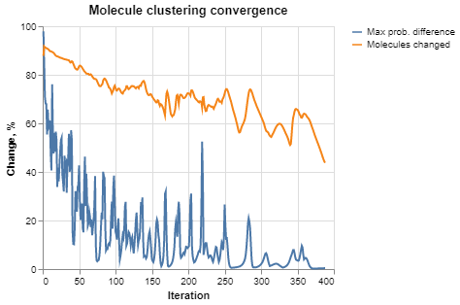
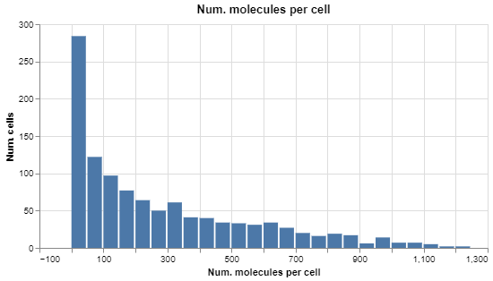
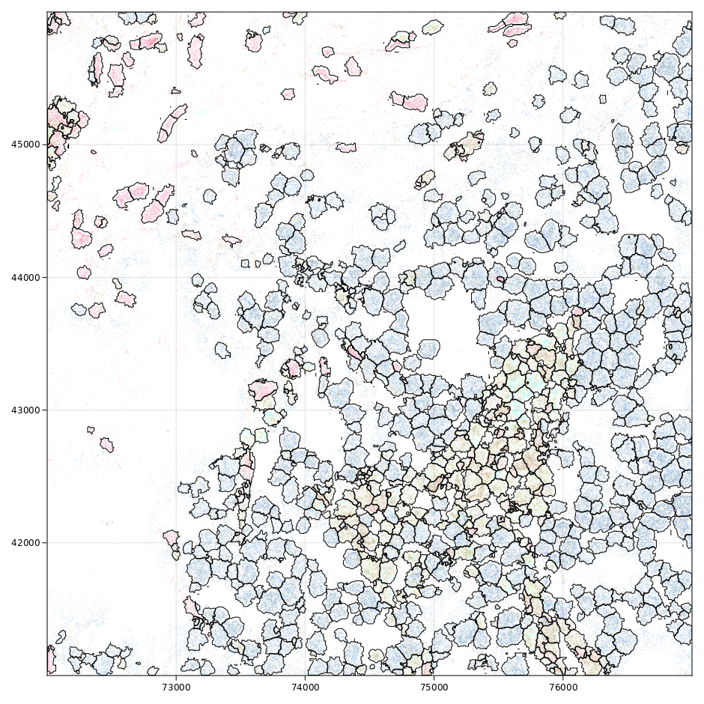
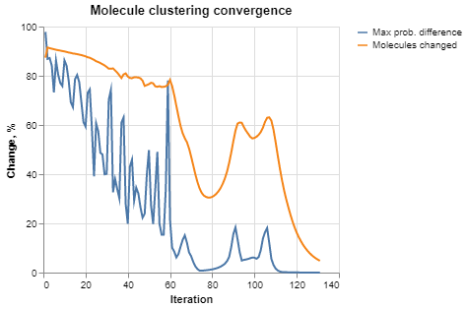
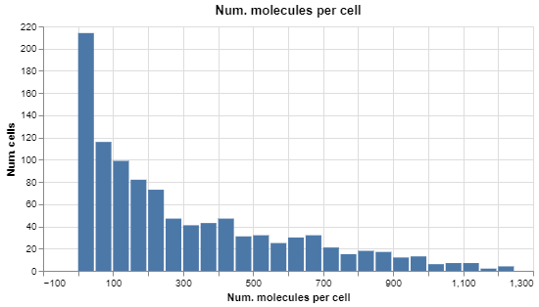
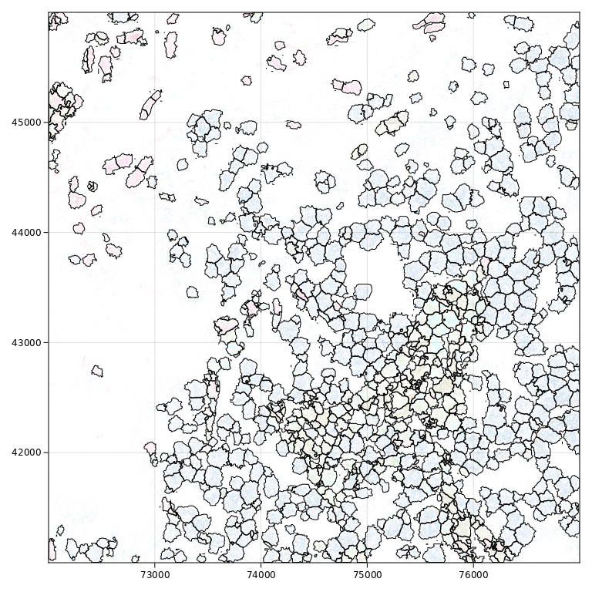
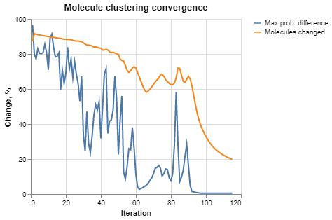
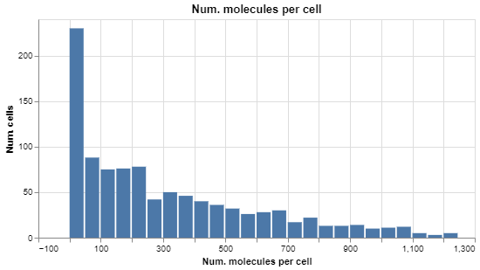
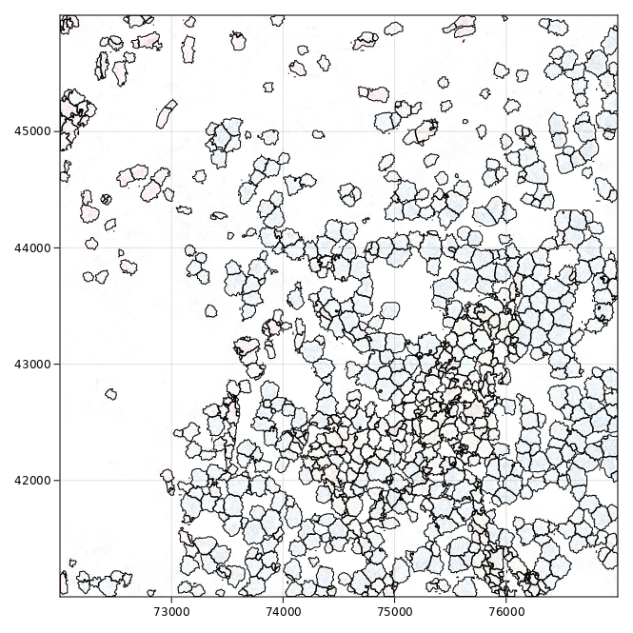
S = 50
Std = 50%
M = 100
W = 0.2
S = 50
Std = 50%
M = 150
W = 0.2
S = 50
Std = 50%
M = 200
W = 0.2

Slide 4
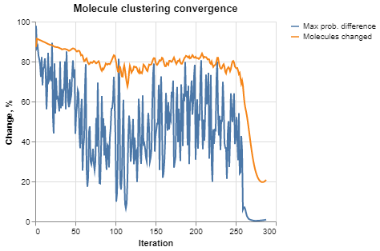
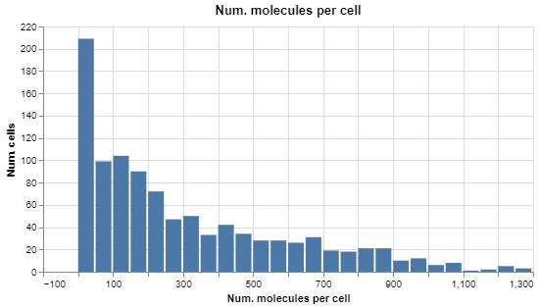
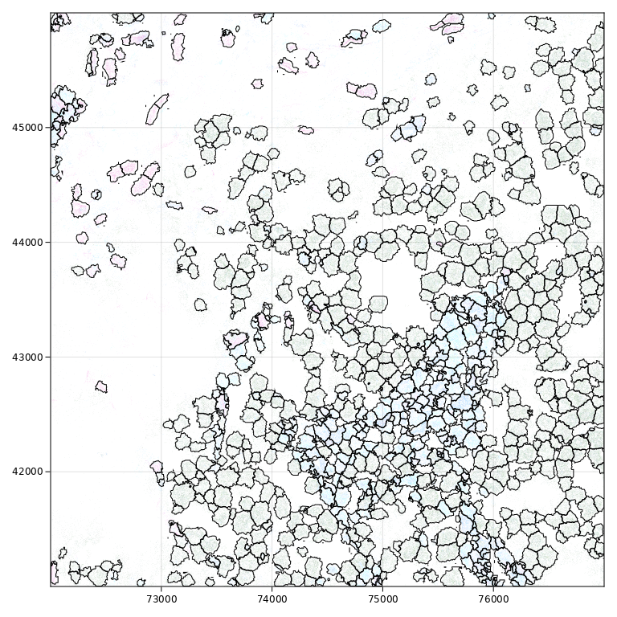
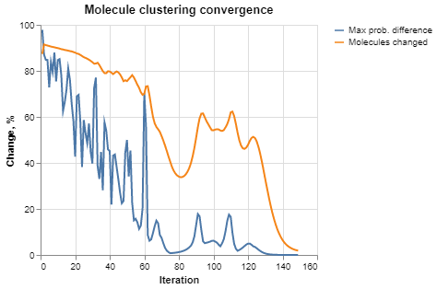
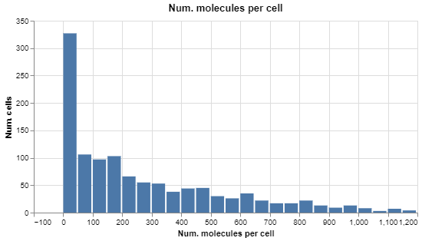

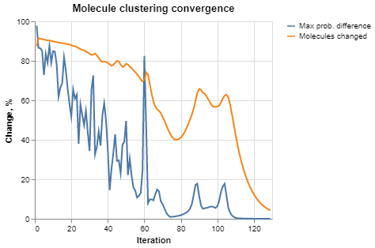
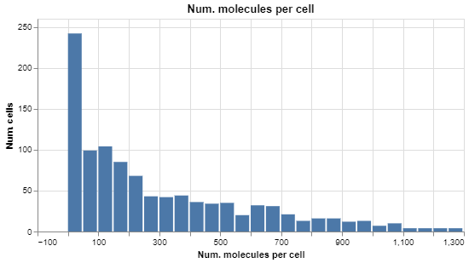

S = 50
Std = 50%
M = 150
W = 0.1
S = 50
Std = 50%
M = 150
W = 0.5
S = 50
Std = 50%
M = 200
W = 0.8

Slide 5
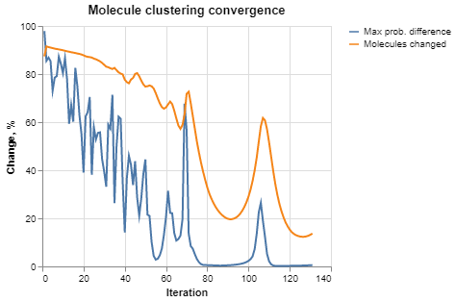
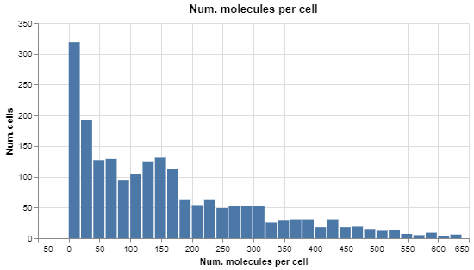
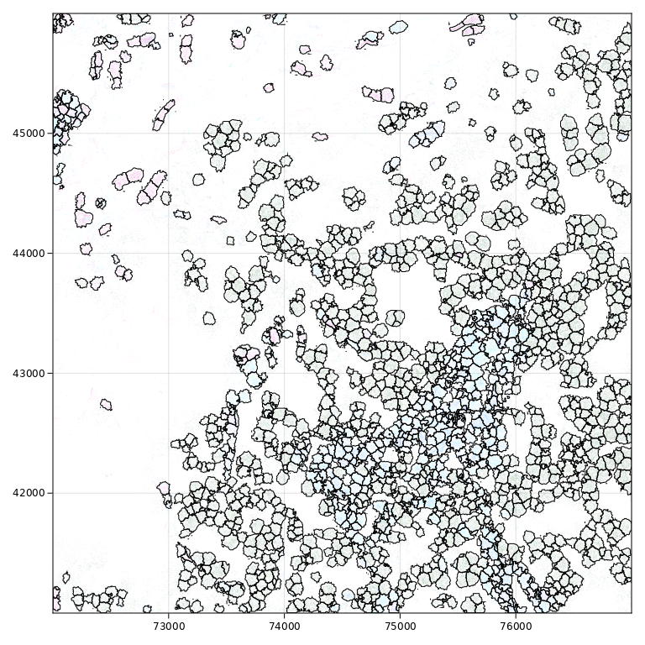

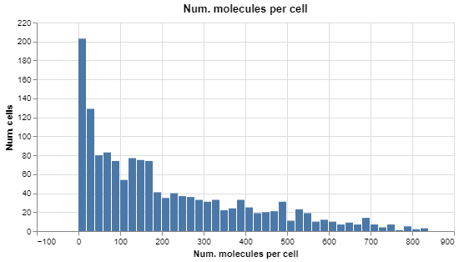

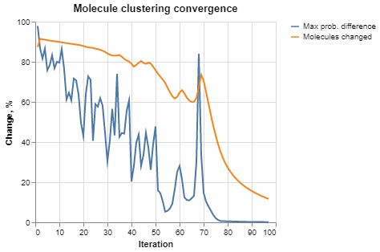
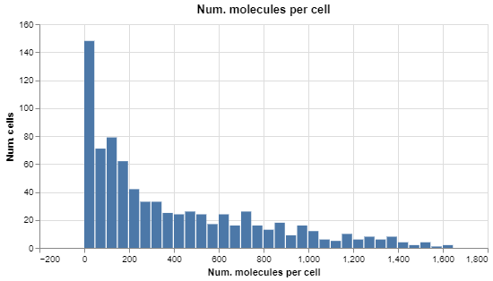
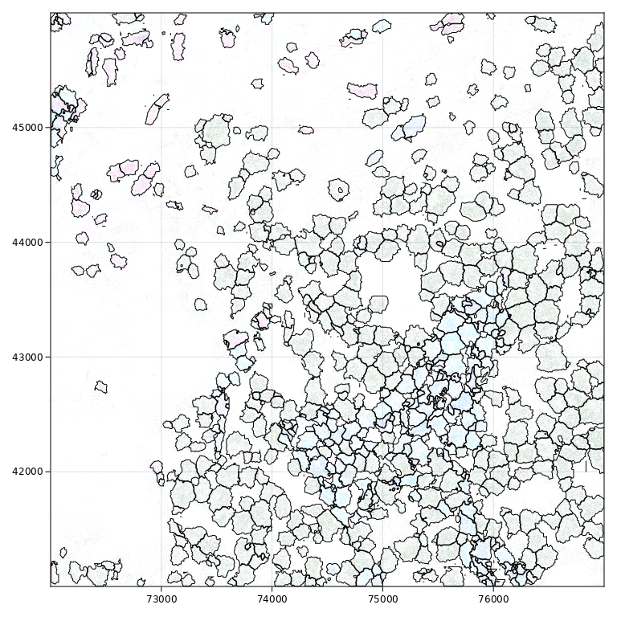
S = 35
Std = 50%
M = 150
W = 0.2
S = 40
Std = 50%
M = 150
W = 0.2
S = 60
Std = 50%
M = 150
W = 0.2

Slide 6
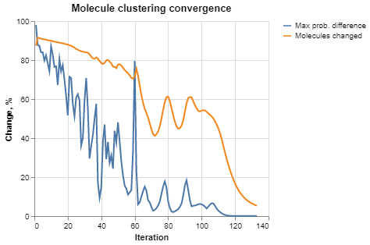
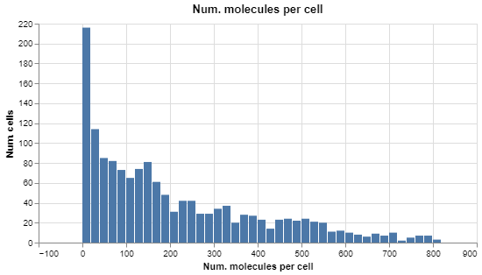

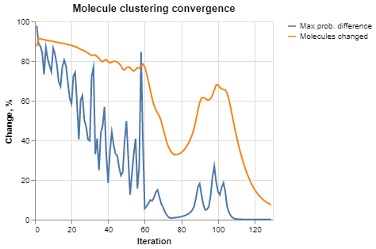
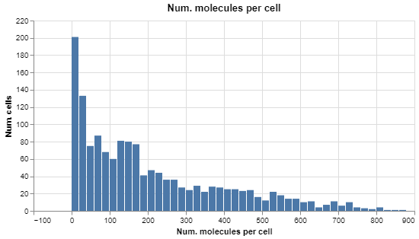

S = 40
Std = 25%
M = 150
W = 0.2
S = 40
Std = 75%
M = 150
W = 0.2

Slide 7
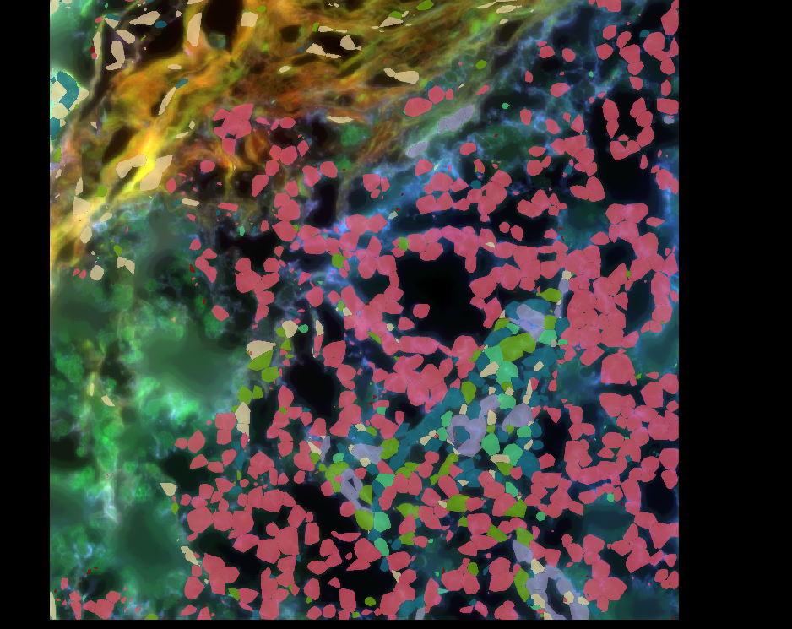
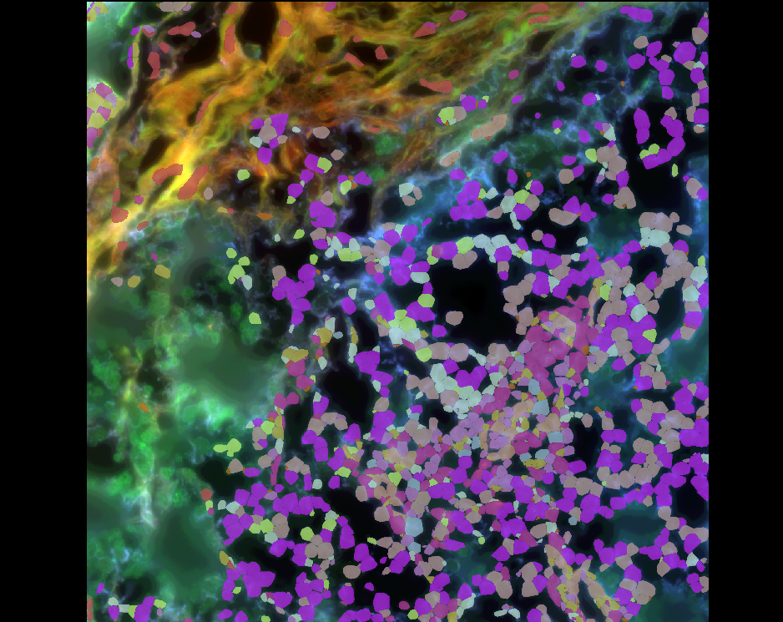
Original
(M=20, S=50, Std=50%, W=0.2)
M=150, S=40, Std=50%, W=0.2

Slide 8
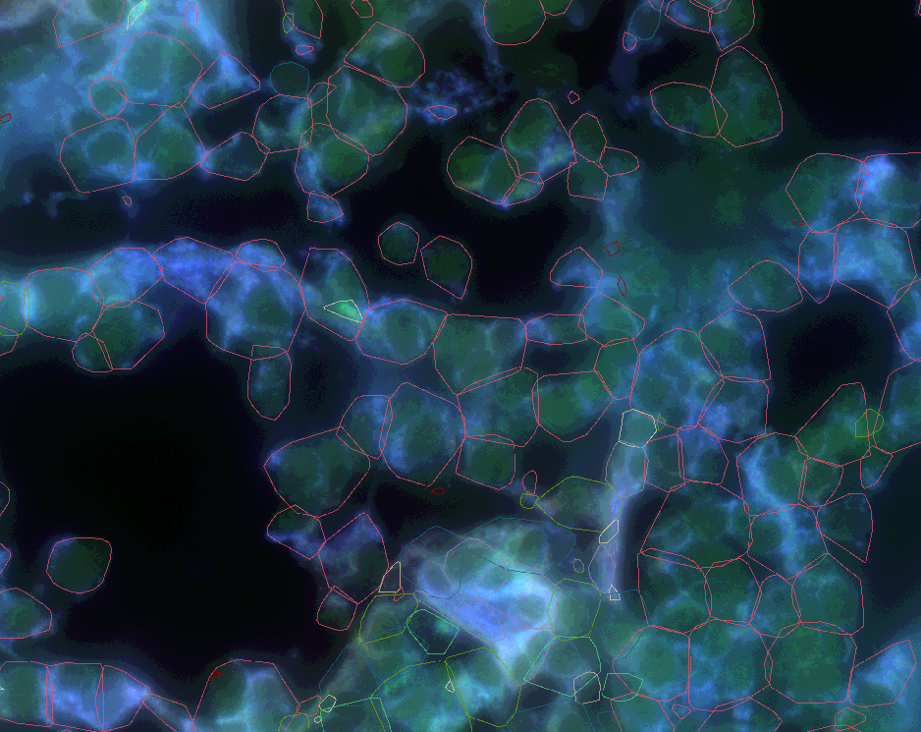
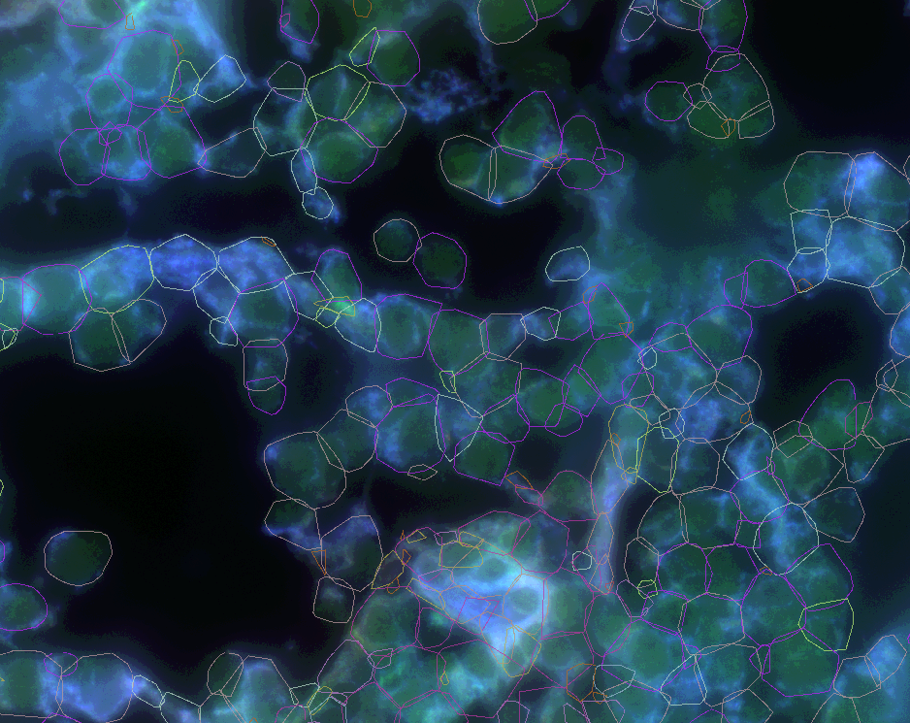
Original
(M=20, S=50, Std=50%, W=0.2)
M=150, S=40, Std=50%, W=0.2

Slide 9
Summary Statistics
 | Demo | *Original | **M150_s40_std50_w0.2
# Probes | 135 | 398 | 398
Genes/cell, Q25 | 11 | 16 | 29
Genes/cell, Q50 | 21 | 55 | 65
Genes/cell, Q75 | 36 | 115 | 104
Counts/cell, Q25 | 25 | 24 | 46
Counts/cell, Q50 | 79 | 129 | 152
Counts/cell, Q75 | 192 | 377 | 329
*Statistics from entire tissue image
**Statistics from small test region
Q[N] = N% quantile

Slide 10
Conclusions
Baysor is robust to many parameter tweaks. By far, the most impactful parameter is cell size.
Diagnostics are helpful, but the only reliable way to evaluate segmentation is with reliable cell staining…
In comparison to the demo data and scaling expectations by # probes in experiment, the recent data are of expected quality.

